Slide 1

SecureBank: A Secure Online Banking System
Presented by:
Muhammad Azfar Waqas UW-23-CY-BS-013
Ibrar Ul Hassan Shami UW-23-CY-BS-018
Saad Ali UW-23-CY-BS-050
University of Wah - BS Cybersecurity 4th Semester

Slide 2

Project Overview
Simulated Online Banking
Web application for banking operations.
Flask-Powered
Built with Python's Flask framework.
Security First
Focus on user authentication, secure transactions.

Slide 3

Technologies Utilized
Flask Ecosystem
Frontend Stack
Python Web Framework
HTML, CSS, Bootstrap
Flask-Mail for emails
Responsive UI design
Security & Data
bcrypt for hashing
JSON for storage
itsdangerous for tokens

Slide 4





Core Features
SecureBank provides essential banking functionalities with a strong emphasis on security.
User Registration
Secure Login
Fund Transfers
Email confirmation.
Authenticated access.
Deposit and withdrawal.
Transaction History
View past activities.
Additionally, users can securely reset their passwords.

Slide 5

Implemented Security Measures
Our system employs multiple layers of security to protect user data and transactions.
Password Hashing
Email Verification
Bcrypt for strong encryption.
Timed tokens ensure authenticity.
Input Validation
Session Control
Regex for strict data integrity.
Secure access management.

Slide 6





Email Confirmation Flow
User Registration
New user signs up.
Email Sent
Confirmation email dispatched.
Token Generation
itsdangerous creates secure token.
Timed Link
Valid for 1 hour only.
Verification Required
Login only after email confirmation.

Slide 7

Password Reset Flow
A secure process to regain account access.
Request Reset
User enters registered email.
Receive Link
Email contains unique reset link.
Timed Access
Link expires in 30 minutes.
New Password
System enforces strong password rules.

Slide 8

Transaction Functions
SecureBank provides core banking operations with detailed record-keeping.
Deposit
Adds specified amount to user balance.
Withdrawal
Validates sufficient funds, deducts amount.
History
Logs all transactions with timestamps for auditing.

Slide 9
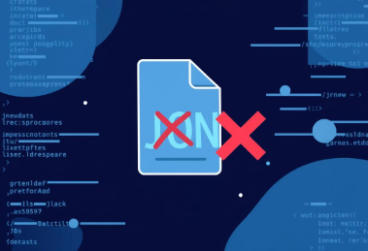
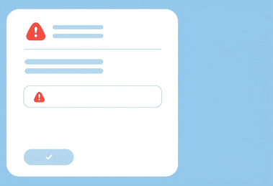


Robust Exception Handling in Our Codebase
Ensuring Stability and Reliability
Invalid JSON
Invalid Deposit/Withdraw Input
Token Expiry
Email Send Failures
The load_users() function uses try/except blocks. This handles malformed JSON data gracefully. It prevents application crashes.
Input for financial transactions is strictly validated. A try/except structure ensures only numerical values. This prevents errors from non-numeric entries.
In confirm_token(), try/except manages expired tokens. This ensures secure user sessions. It prompts users to re-authenticate when needed.
Adding try/except around email sending is crucial. It will catch network issues or invalid addresses. Implement retry mechanisms for resilience.

Slide 10





Future Enhancements
Expanding SecureBank's capabilities and robustness.
Database Migration
Integrate SQL (SQLite/PostgreSQL).
Two-Factor Auth
Add 2FA for heightened security.
CAPTCHA Integration
Combat automated bots.
Dashboard UI
Enhance reporting and user experience.

Slide 11






Conclusion
Real-World Practice
Promotes practical cybersecurity skills.
Secure Design
Demonstrates robust web application security principles.
Fintech Foundation
Basis for advanced financial technology projects.

